Slide 1
Automated Cellular Classification
Michael Morehead

Slide 2
Outline
Goal of Project
  Problem
  Representations
Two common methods:
  Signature models
  Graph-based models
Combination

Slide 3
The Problem
Given a set of neuron models, is it possible to automatically predict the cell type, age, function, etc.
Neuron models could be:
  EM resolution models stored as OBJs
  Light microscopy “ball-and-stick” models stored as SWC

Slide 4
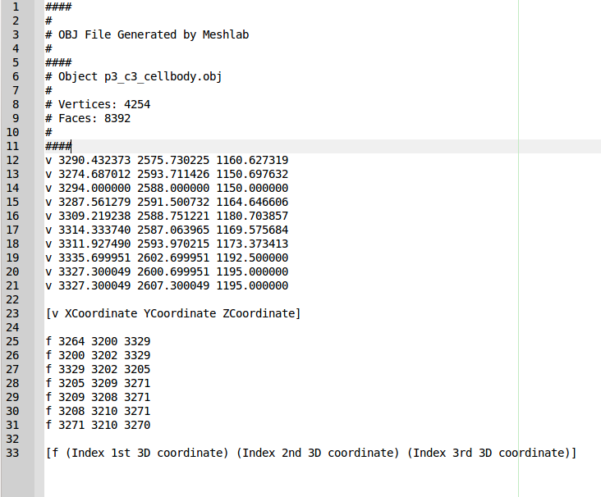
OBJ format

Slide 5
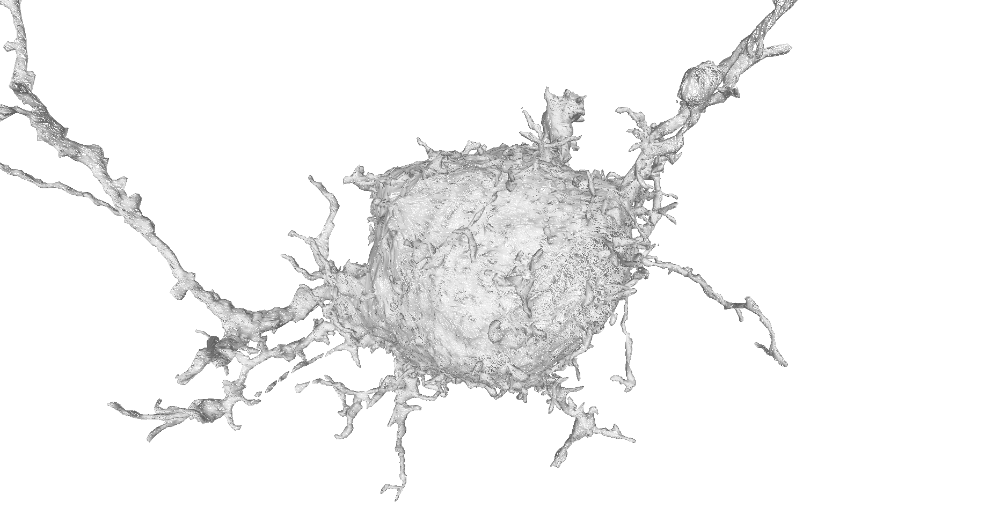
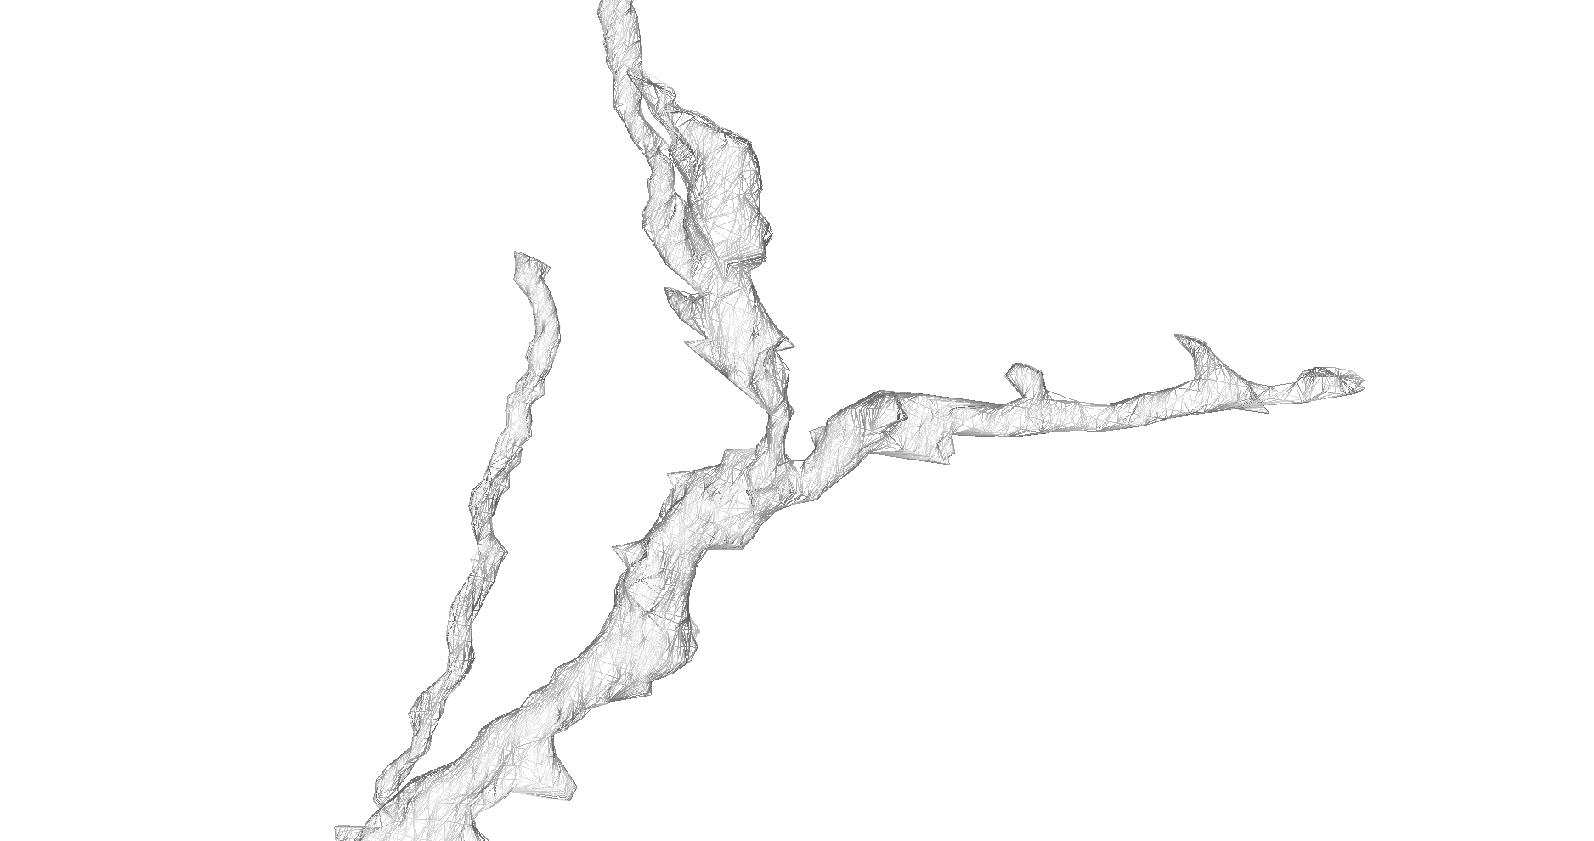

Slide 7
SWC Format
# Original file ca3b-N2.swc edited using StdSwc version 1.31 on 10/10/11.
# Irregularities and fixes documented in ca3b-N2.swc.std. See StdSwc1.31.doc for more information.
#
# NEUROMANTIC V1.6.3 (10/10/2011 1:34:13 PM): Saved to ca3b-N2-T1.swc
1 1 436.0 -1566.0 533.2 1.5 -1
2 3 435.1 -1583.0 500.0 1.5 1
3 3 438.2 -1586.0 500.0 1.5 2
4 3 441.3 -1587.0 500.0 1.5 3
5 3 447.3 -1587.0 500.0 1.5 4
6 3 450.6 -1597.0 500.0 1.5 5
7 3 458.1 -1593.0 500.0 1.5 6
8 3 467.1 -1610.0 500.0 1.5 7
9 3 469.3 -1608.0 533.2 1.5 8
10 3 470.9 -1618.0 500.0 1.5 8
11 3 456.5 -1617.0 500.0 1.5 10
12 3 454.3 -1615.0 533.2 1.5 11
13 3 473.3 -1624.0 500.0 1.5 10
14 3 473.6 -1621.0 533.2 1.5 13

Slide 8
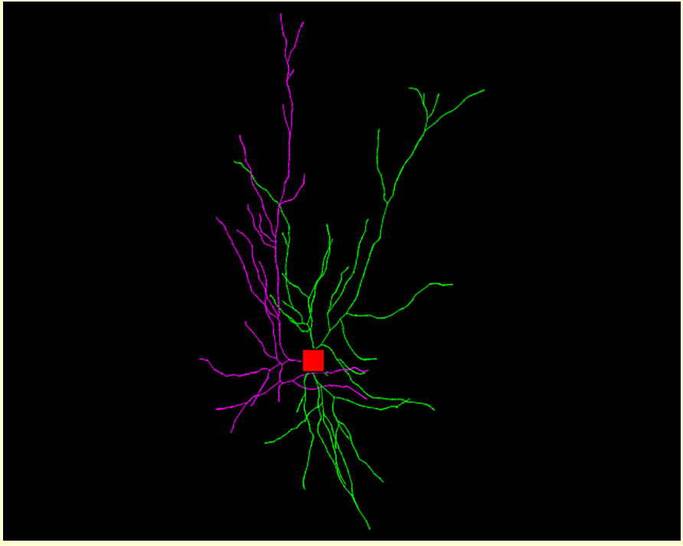

Slide 9
Different current methods
Signature model
  Process point cloud into a feature vector
  works nicely with both data types
  computationally efficient
  reasonably good recognition rates
Graph-based models
  great representational power
  greater computational cost
  trouble getting OBJs into a graph

Slide 10
Novel Signature Model
Extract point cloud from OBJ
Construct Spin Images for randomly selected 1000 points
Cluster spin image histograms into “word” centroids
Produce spin images for some % of remaining points, assign each to nearest centroid
Each cell is described as a feature vector containing the count of each 'word'

Slide 11
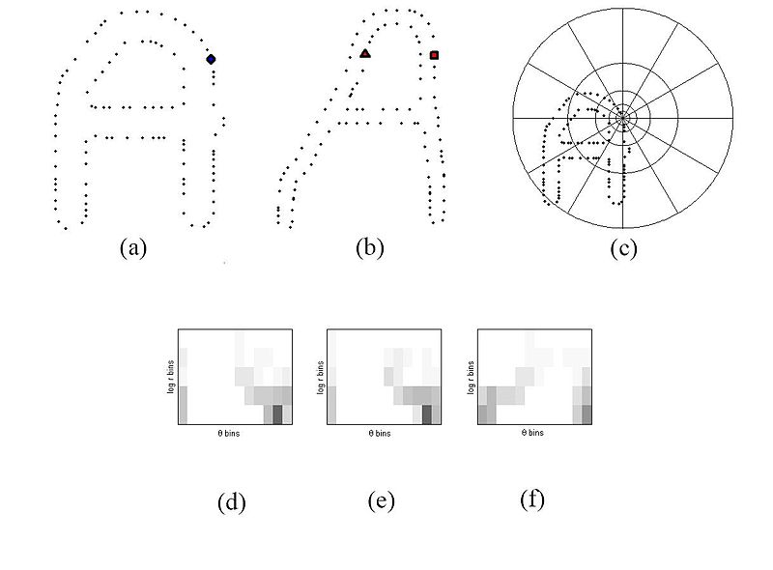
Explanation of Spin Image

Slide 12
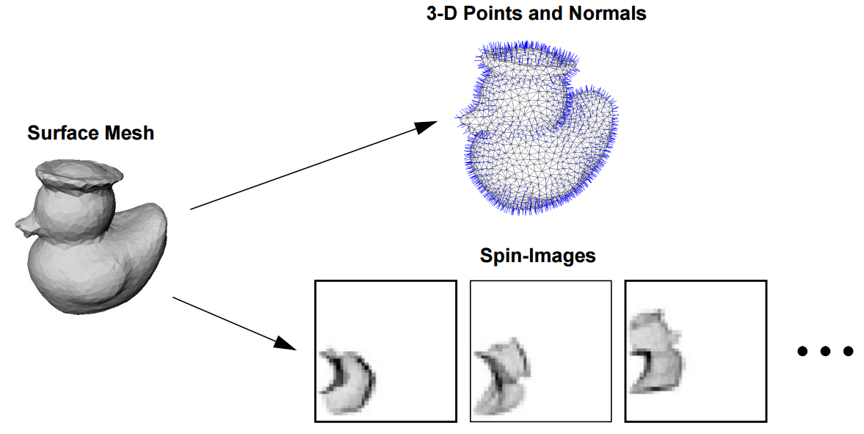
Spin Images

Slide 13
Pros and Cons
CONS
Somewhat time consuming runs (hours)
Too many parameters!
  Spin images
  K-means
  Number points to sample
  % points to map to words
  SVM
Pros
Logically sound
Produces high accuracy

Slide 14
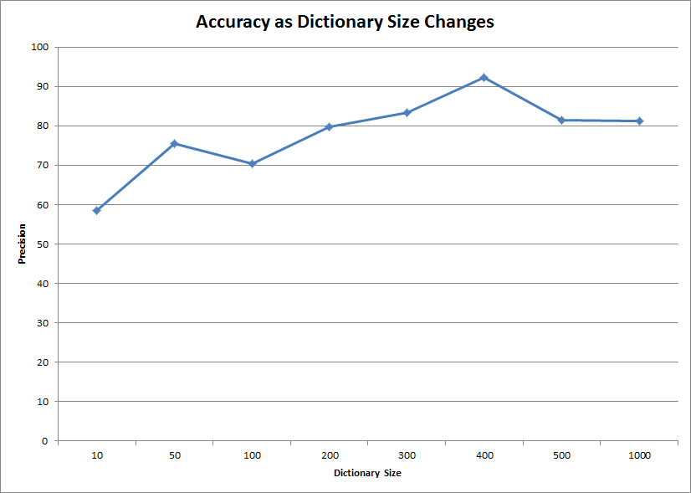
Some results

Slide 15
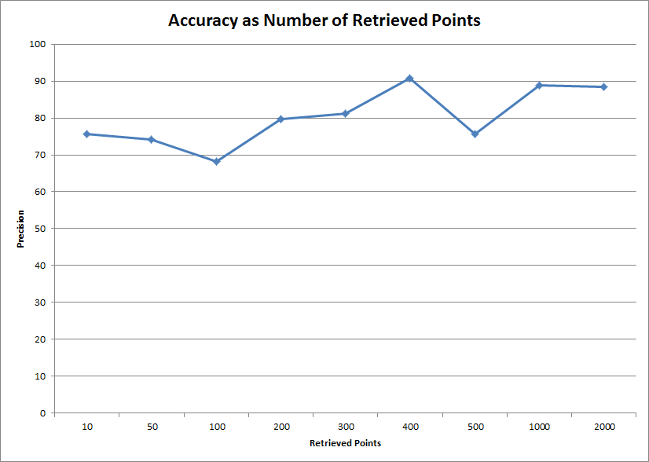
Some results

Slide 16
Graph-based method
Leverages work from geometric tree kernel paper for COPD
Represent cells as graph
Compare each cell-graph to every other cell-graph
Utilize similarity matrix for classification
SVM produced high accuracy (96% LOO)

Slide 17
Problems with Graph
O(n^2) for producing similarity matrix
  Kernel code isn't fast either
  Scaling to thousands of cells could require parallelization
Producing graphs from OBJ open problem
  Currently producing graphs from IMOD files where each slice can be graph node
  Some algorithms attempt to skeletonize cloud points but often introduce artifacts (TEASER algorithm)

Slide 18
Combination
Each node in graph can contain a feature vector
Load shape context into each node provides high representation of both graph structure and local shape descriptor
Untested...

Slide 19
Production of Graphs
Use Knossos to extract skeleton from EM manually
Probably take 2-3 hours/cell
5–10 hours/mm path length
Utilize graph to assist full volume segmentation
Currently in production

Slide 20
Questions?

